Slide 1
5
Functions
Objectives
In this chapter, you’ll:
Construct programs modularly from small pieces called functions.
Use common math functions from the C standard library.
Create new functions.
Understand how function prototypes help the compiler ensure that you use functions correctly.
Use the mechanisms that pass information between functions.
See some commonly used C standard library headers.
Learn how the function call and return mechanism is supported by the function-call stack and stack frames.
Build a casino game using simulation techniques and random-number generation.
Understand how an identifier’s storage class affects its storage duration, scope and linkage.
Write and use recursive functions, i.e., functions that call themselves.
Continue our presentation of Secure C programming with a look at secure random-number generation.

Slide 2
5.1 Introduction
Most computer programs that solve real-world problems are much larger than those presented in the first few chapters.
Experience has shown that the best way to develop and maintain a program is to construct it from smaller pieces, each of which is more manageable than the original program.
This technique is called divide and conquer.

Slide 3
5.2 Modularizing Programs in C
In C, you use functions to modularize programs by combining the new functions you write with prepackaged C standard library functions.
The C standard library provides a rich collection of functions for performing common mathematical calculations, string manipulations, character manipulations, input/output and many other useful operations.
Avoid Reinventing the Wheel
Familiarize yourself with the rich collection of C standard library functions to help reduce program-development time.
When possible, use standard functions instead of writing new ones.

Slide 4
5.2 Modularizing Programs in C
Defining Functions
Functions are invoked by a function call, which specifies the function name and provides information (as arguments) that the function needs to perform its designated task.
A common analogy for this is the hierarchical form of management. A boss (the calling function or caller) asks a worker (the called function) to perform a task and report back when it’s done.
Function printf displays the data and reports back—or returns—to the caller when it completes its task.

Slide 5
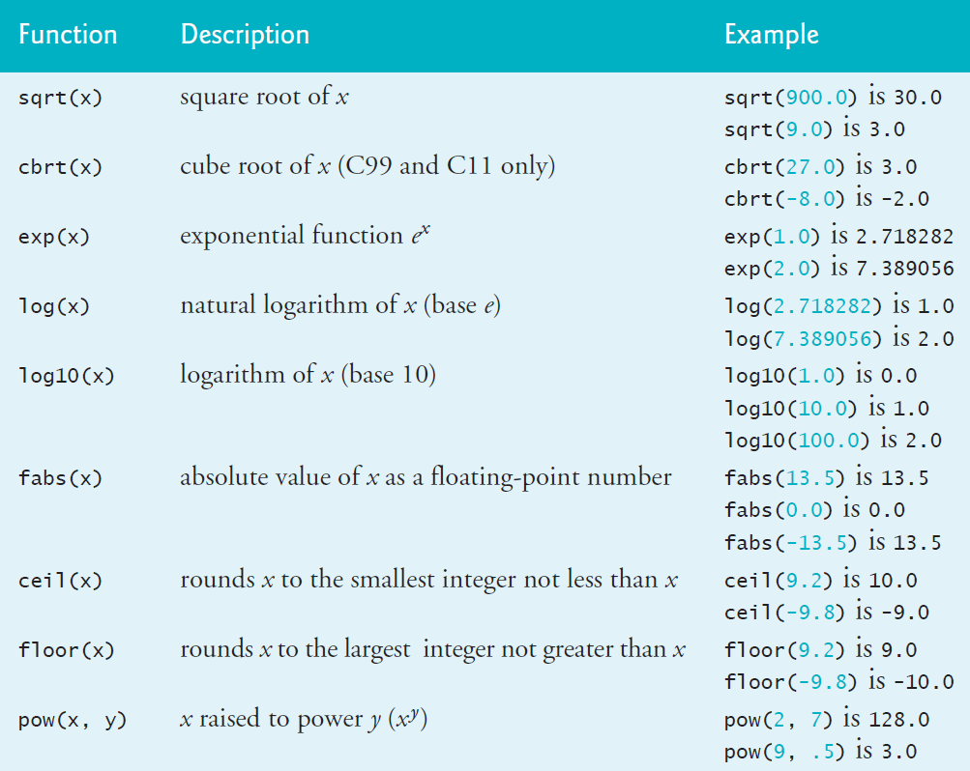
5.3 Math Library Functions
C’s math library functions (header math.h) allow you to perform common mathematical calculations.
We use many of these functions in this section.
To calculate and print the square root of 900.0 you might write
printf("%.2f", sqrt(900.0));

Slide 6
5.4 Functions
Functions allow you to modularize a program. In programs containing many functions, main is often implemented as a group of calls to functions that perform the bulk of the program’s work.
Functionalizing Programs
There are several motivations for “functionalizing” a program. The divide-and-conquer approach makes program development more manageable.
Another motivation is building new programs by using existing functions. Such software reusability is a key concept in object-oriented programming languages derived from C, such as
C++,
Java,
C# (pronounced “C sharp”),
Objective-C and
Swift.

Slide 7
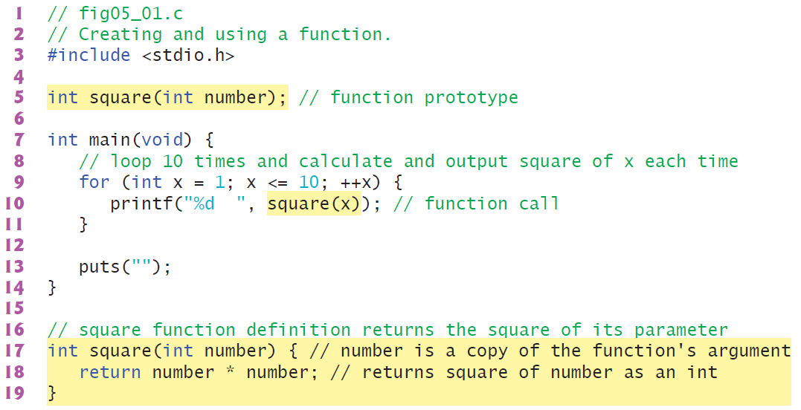
5.5 Function Definitions
Each program we’ve presented has consisted of a function called main that called standard library functions to accomplish its tasks. Now we consider how to write custom functions.
5.5.1 square Function
Consider a program that uses a function square to calculate and print the squares of the integers from 1 to 10

